Slide 1
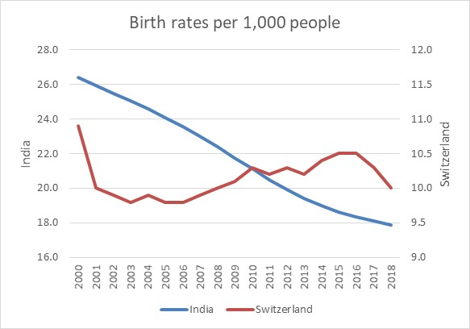
Time series data - Long term forecasts and seasonality
Trend?
Forecasting and Errors?
The aim of this chapter is to provide the reader with a set of tools which can be used for time series analysis and extrapolation. This chapter will allow you to apply several time series methods for long-term forecasting and extrapolation.

Slide 2
Learning Objectives
On completing this unit, you should be able to:
Part 1 Trend
Understand the time series fundamentals.
Be able to inspect and prepare data for forecasting.
Graph the data and visually identify patterns.
Fit an appropriate model using the time series approach.
Use the identified model to provide an extrapolation.
Calculate a measure of error for the model fit to the data set.
Learn how to calculate prediction interval.
Solve problems using the Microsoft Excel and SPSS.
Part 2 Seasonality
Learn how to handle seasonal time series and apply the decomposition method.
Solve problems using the Microsoft Excel and SPSS.

Slide 3
Introduction to time series analysis (1/2)
In this chapter, we apply the regression analysis principles to one single variable, measured in time. This implies that we still have two variables, but one of them is the time. Previously we fitted a line equation that best describes relationship between a dependent variable (y) and an independent (or predictor) variable (x).
In this chapter we still use only one dependent variable (y), whilst the independent variable (x) is a sequence of numbers representing time. The other addition to what we learned is extrapolation. In linear regression, we used the model to estimate the value of y, given the knowledge of x.
Forecasting means extrapolating the variable into the future, by relying on its history. Extrapolation implies that we can take the future values of x and estimate what the potential value of y might be.

Slide 4
Introduction to time series analysis (2/2)
So, how do we define a time series? A time series is a variable that is measured and recorded in equidistant units of time. A good example is inflation. We can record monthly inflation, quarterly inflation or annual inflation. All three data sets represent a time series. In other words, it does not matter what units of time we use, as long they are consistent and sequential.
By consistent, we mean that we are not allowed to mix the units of time (daily with monthly data or minute with hourly data, for example). By sequential, we mean that we are not allowed to skip any data points and have zeros or empty values for any point in time.
Should this happen, we need to estimate somehow the missing value by calculating the average of the two neighbouring values, or any other appropriate method.

Slide 5
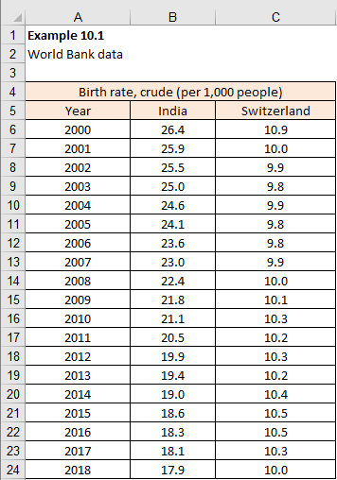
Stationary and non-stationary data sets (1/2)
Example 10.1 consists of two different time series data sets. The data sets come from the World Bank and they show the birth rates in India and Switzerland per 1,000 people from 2000-2018 (the most recent year for which the data is available is 2016). If we just looked at the data in columns B and C, in Figure 10.1, we could conclude very little. However, if we plot these numbers, as in Figure 10.2, we immediately see the difference.
Example 9.1

Slide 6
Stationary and non-stationary data sets (2/2)
The data for Switzerland shows a line that seems to be moving horizontally, oscillating around some central value.
Meanwhile, the data for the India seems to be moving downwards, which implies that some central value must be a moving value.
The time series representing birth rates for Switzerland, following a horizontal line, is called stationary, whilst the time series for India is called a non-stationary time series.

Slide 7
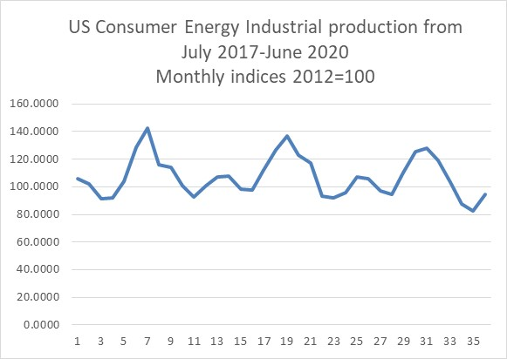
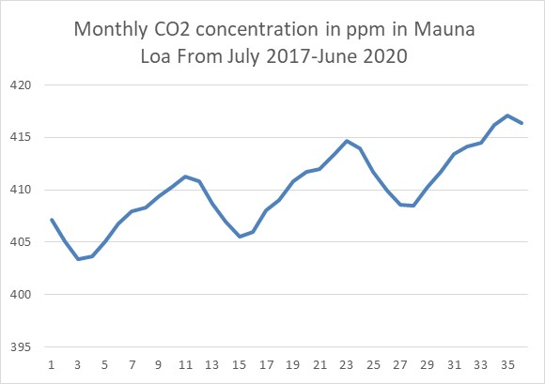
Seasonal time series
In addition to distinguishing every time series as either a stationary or non-stationary, every time series can also be either seasonal or non-seasonal. Again, a variety of methods exist to treat specifically seasonal time series.
Example 10.2
Here is an example of one seasonal and stationary time series (Figure 10.4) and one seasonal and non-stationary time series (Figure 10.5).

Slide 8
Part 1 Trend extrapolation as long-term forecasting method
Long term forecasting is essentially the same as trend extrapolation. If we are going to produce long-term forecasts, this implies that we are not interested in every detail of the future time series. We are interested in the general direction and the speed (slope) at which the future values of the variable are going to happen. Long-term forecasts do not mean that we must go a number of years in the future. It means that we want to go several time periods in the future.
What we are saying is that regardless of units of time (years, days, minutes), long term-forecasting implies that we are going to forecast the values of the variable for a considerable number of time periods. What is considerable number of time periods? Well, it depends how long is the time series. A general and empirical rule is that long-term forecasts should not exceed one third on the total number of historical observations (n/3).
As an example, if your time series consists of 36 observations (n), the maximum number of forecasts to be produced should not exceed 12 (n/3).

Slide 9

A trend component (1/2)
Let’s say that, for all practical purposes, we are only interested in estimating the trend. After we calculated the trend, that models the time series, the difference between every actual value in the time series and every trend value is effectively a series of residuals (R). In other words, time series Y, in this simplified model, consists of only two components, as defined by equation (9.1).
If a trend represents an underlying pattern that the time series follows, then the residuals are something that should randomly oscillate around the trend. In other words, if we can estimate the underlying trend of a time series, we will not worry about these random residuals fluctuating around the trend line (at least in the context of long-term forecasts). We can then extrapolate this trend. The trend becomes our forecast of the time series.

Slide 10
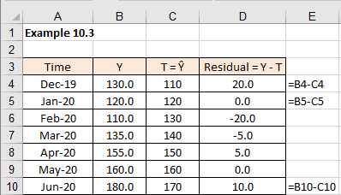
A trend component (2/2)
Example 10.3
Our simplified example in Figure 10.6 shows that the trend we calculated is in fact the forecast Ŷ.
If we add the residuals to the trend, we will get the values of the actual time series Y. Just as per our equation (10.1).
This simplified example makes the point that you can create reasonable long-term forecasts by only focusing on the trend. For short term forecasts this approach would be “short” of expected precision, but we will tackle this problem in the following chapter.

Slide 11
Fitting a trend to a time series – Excel (1/5)
If a trend is the underlying pattern that indicates the general movements and the direction of a time series, then this implies that a trend can be described by some regular curve. This usually means a smooth curve, such as a straight line, a parabola or a sinusoid, or any other well-defined curve.
Year | Price per litre (p) |  | Year | Price per litre (p)
1983 | 36.7 |  | 2002 | 610.9
1984 | 38.7 |  | 2003 | 77.9
1985 | 42.8 |  | 2004 | 77.9
1986 | 38.2 |  | 2005 | 710.9
1987 | 37.8 |  | 2006 | 88.9
1988 | 34.7 |  | 2007 | 87.9
1989 | 38.4 |  | 2008 | 103.9
1990 | 40.2 |  | 2009 | 810.9
1991 | 310.5 |  | 2010 | 111.9
1992 | 40.3 |  | 2011 | 1210.9
1993 | 45.9 |  | 2012 | 134.1
1994 | 48.9 |  | 2013 | 138.9
1995 | 50.9 |  | 2014 | 130.9
1996 | 52.9 |  | 2015 | 1010.9
1997 | 57.9 |  | 2016 | 103.9
1998 | 60.9 |  | 2017 | 117.9
1999 | 61.9 |  | 2018 | 115.9
2000 | 76.9 |  | 2019 | 1110.9
2001 | 77.9 |  | 2020 | 1110.9
Example 10.4
We will use a time series representing average annual UK petrol prices in pence per litre 1983-2020 (leaded 4-star up to 1988, unleaded thereafter). The time series consists of 38 observations, as illustrated in Table 10.3.

Slide 12
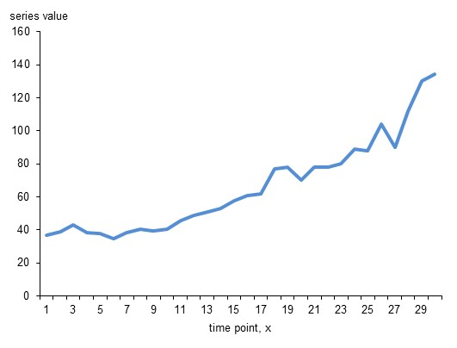
Fitting a trend to a time series - Excel (2/5)
When charted as a line graph, the time series looks as illustrated in Figure 10.7.

Slide 13
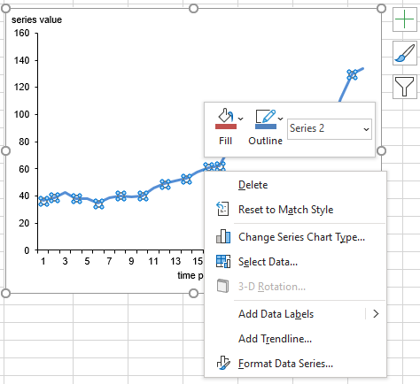
Fitting a trend to a time series – Excel (3/5)
To fit a trend line to the time series is a very easy graphical process in Excel, as we already demonstrated in Chapter 9.

Slide 14
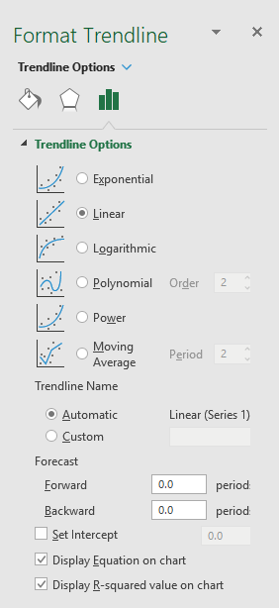
Fitting a trend to a time series – Excel (4/5)
After selecting Add Trendline, choose Linear Option, as well as Display Equation on chart, and Display R-squared on chart (see Figure 10.9). Click on close.

Slide 15
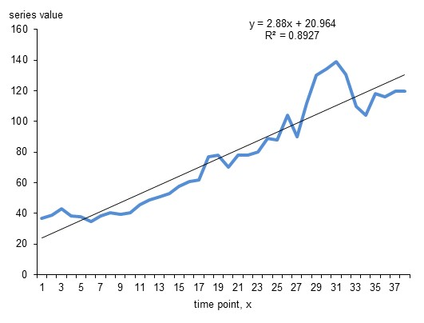
Fitting a trend to a time series – Excel (5/5)
The final graph with the trend line automatically added is illustrated in Figure 10.10 with the line equation and coefficient of determination included.
What we are getting here instantly is a straight line that describes the underlying movement and the direction of our time series. This is the trend of the time series and, if extrapolated, it becomes a forecast.

Slide 16
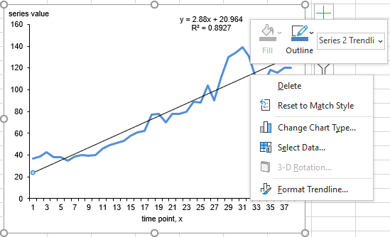
Using a trend chart function to forecast time series - Excel (1/4)
It is quite a simple task to use the fitted Excel trend line to forecast, for example, five time periods into the future.
Right-click on the trend line on the graph and choose Format Trendline as illustrated in Figure 10.11.

Slide 17
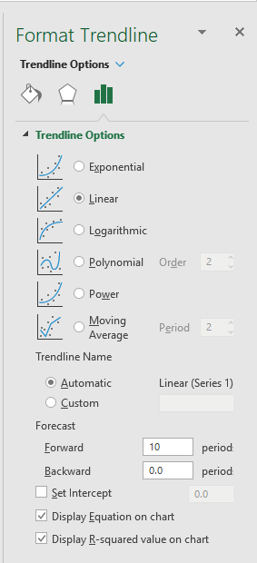
Using a trend chart function to forecast time series – Excel (2/4)
In Figure 10.12 we will opt for an automatic trend line that will move 10 periods in the future.

Slide 18
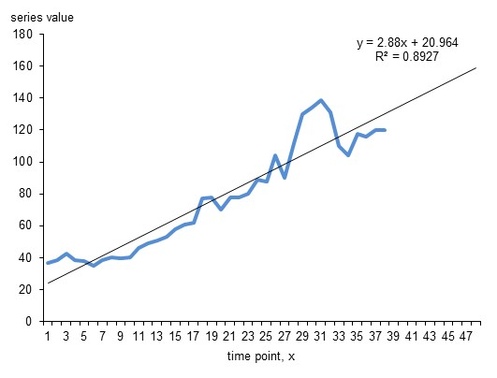
Using a trend chart function to forecast time series - Excel (3/4)
Figure 10.13 illustrates the modified time series chart with the trend line extended by 5 time periods to provide a forecast for time points 39 to 48.

Slide 19
Using a trend chart function to forecast time series - Excel (4/4)
We can see that the actual time series is not a smooth straight line, but it oscillates around the smooth straight line that we have estimated. By extrapolating our straight line, or linear trend, into the future, we are anticipating that our forecasts might not be completely accurate, but we believe that it represents well the direction and the shape of our variable.
Excel does not just give us a pictorial of this trend line, but the actual equation of this line. From Figure 10.13, we can see that this trend line is moving in accordance with the equation: y = 2.88x + 20.964. The R-squared (or R²) value is 0.89.
As we know, the closer R² is to the value of 1, the better the fit of the trend to time series. In our case R-squared is 0.89, which is very good. This confirms that our trend is approximating, or fitting, the historic data very well. Only 11% (1 - 0.89 = 0.11) of data variations are not explained, by the trend line. This is more than reasonable.

Slide 20
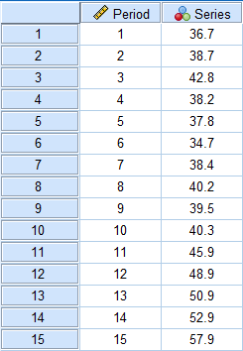
Using a trend chart function to forecast time series - SPSS (1/7)
Enter data into SPSS – first 15 data values shown in Figure 10.14

Slide 21
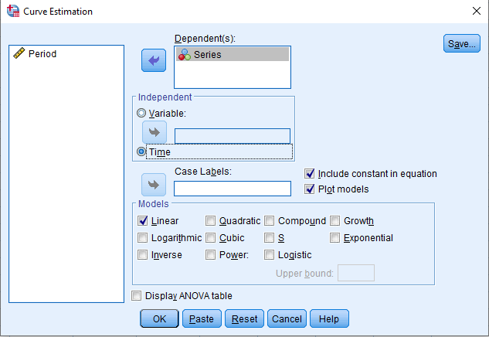
Using a trend chart function to forecast time series - SPSS (2/7)
SPSS Curve Fit
Analyze > Regression > Curve Estimation
Transfer the variable Series to the Dependent (s) box
Choose Independent Variable: time
Choose Models: Linear

Slide 22
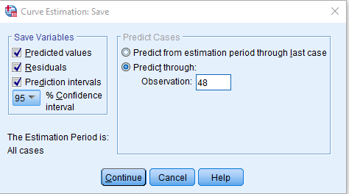
Using a trend chart function to forecast time series - SPSS (3/7)
Select Save
Choose Save Variables:
Predicted values
Residuals
Prediction intervals, 95% confidence interval
Predict Cases – Predict through Observation = 48
Select Continue
Select OK

Slide 23
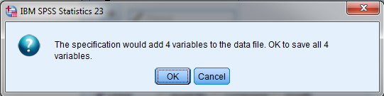
Using a trend chart function to forecast time series - SPSS (4/7)
When you click OK the following menu appears, choose OK

Slide 24
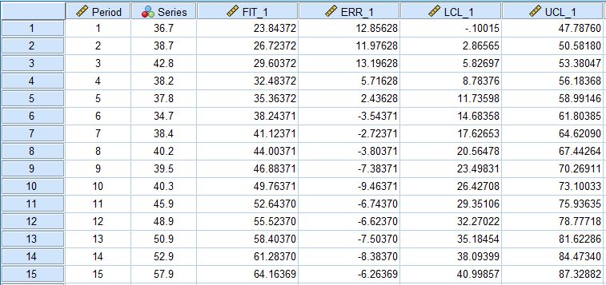
Using a trend chart function to forecast time series - SPSS (5/7)
SPSS Data File
SPSS data file modified to include predicted values, residuals, forecast values for time points 39-48, and prediction intervals. We will return to prediction intervals in greater detail later in this chapter. Figure 10.18 represents the first 15 data values in screenshot

Slide 25
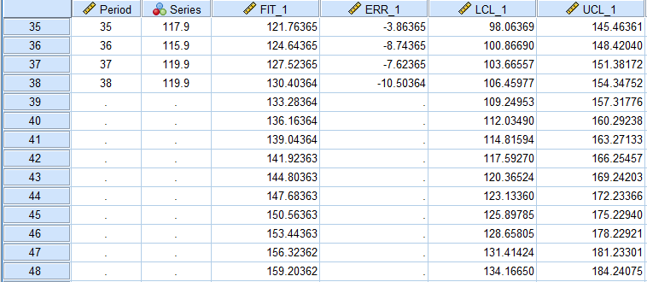
Using a trend chart function to forecast time series - SPSS (6/7)
Figure 10.19 represents the forecast values for time points 39-48 [manually entered time points t = 39 to 48].
This gives:
Fit_1 gives the Trend value
LCL_1 and UCL_1 give the confidence intervals for these time points x = 1 to 48.

Slide 26
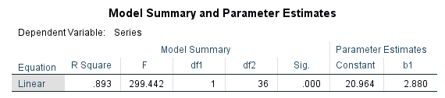
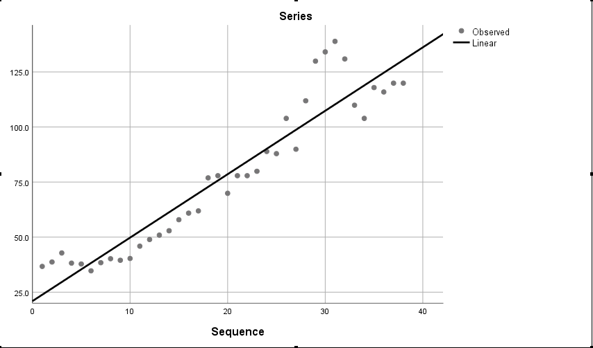
Using a trend chart function to forecast time series - SPSS (7/7)
SPSS Output
The trend line equation statistics are provided in Figure 10.20 (T = 20.964 + 2.888 * time point)with a time series plot in Figure 10.20.

Slide 27

Trend parameters and calculations – Excel (1/6)
Think of the equation y = 2.88x + 20.964 as a specific case, fitted to our data set.
In previous chapter we used equation (8.6)
In fact, this is the same equation.
Do not be confused with the notation. In most textbooks this equation is written as y = ax + b, or y = a + bx. Whatever the case, the letter that stands alone (without x) is called an intercept and the other letter associated with x, is called the slope. To avoid further confusion, let’s standardize to a formula: y = a + bx. Clearly ‘a’ is an intercept and ‘b’ is a slope.
In our case, the value of the intercept is 20.964 and the value of the slope is 2.88.
Chapter 9 explains the meaning of these two parameters.

Slide 28
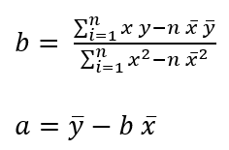
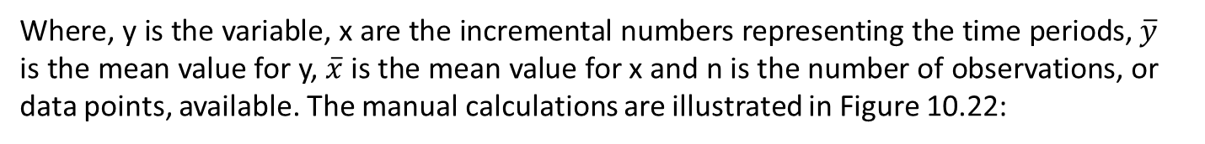
Trend parameters and calculations – Excel (2/6)
Example 10.5
We will use the same numbers as in Example 10.4 and calculate the intercept a, as well as the slope b to show how these calculations are executed manually. We will modify equations (9.8) and (9.9) to make them a bit easier to apply, so the equations for slope (10.2) and the intercept (10.3) are:
Where, y is the variable, x are the incremental numbers representing the time periods, $\overline{y}$ is the mean value for y, $\overline{x}$ is the mean value for x and n is the number of observations, or data points, available. The manual calculations are illustrated in Figure 10.22:

Slide 29
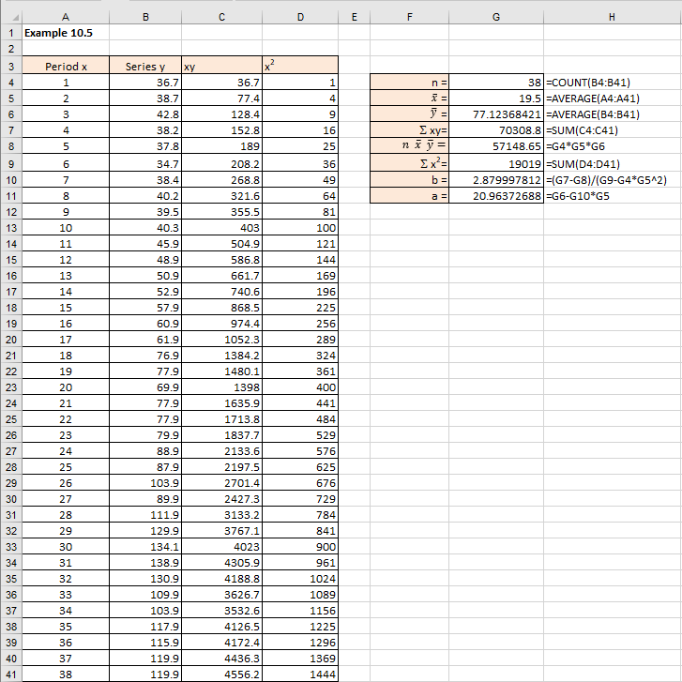
Trend parameters and calculations - Excel (3/6)

Slide 30

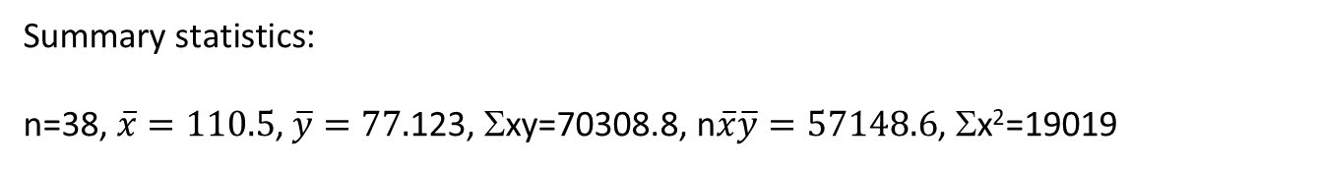
Trend parameters and calculations - Excel (4/6)
Summary statistics:
n=38, $\overline{x}=110.5$, $\overline{y}=77.$123, Σxy=70308.8, n$\overline{x}\overline{y}=57148.6$, Σx²=19019
$b=\frac{70308.8−57148.6}{19019−38×110.5^{2}}=2.8$79
$$a=77.123−2.879×110.5=20.964$$
As we can see these numbers agree with what we got from Excel in Figure 10.13.

Slide 31
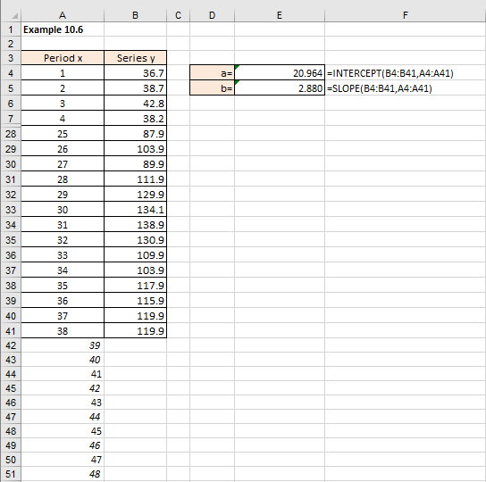
Trend parameters and calculations – Excel (5/6)
Example 10.6
To fit a trend line to a time series data set given the value of the slope of the trend line and its intercept. We can either use built in Excel functions =SLOPE() and =INTERCEPT(), or use one single function called =TREND().

Slide 32
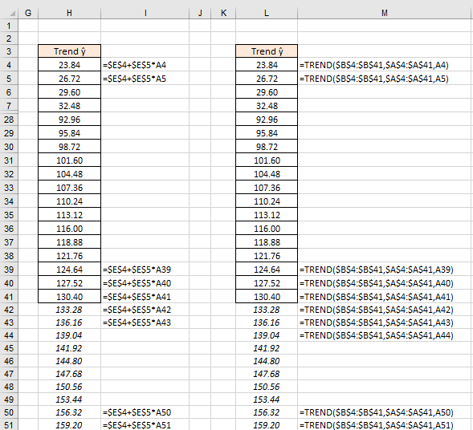
Trend parameters and calculations - Excel (6/6)

Slide 33
Trend parameters and calculations - SPSS
Figures 9.44 – 9.47 show how to calculate the linear regression/trend line coefficients ‘a’ and ‘b’ in linear trend, so we will not repeat this procedure here.

Slide 34
Error measurements (1/7)
One of the primary reasons for forecasting is to try to reduce uncertainty. The better the forecasts, the lower the uncertainty that surrounds the variable we forecast. We can never eliminate uncertainty, but good forecasts can reduce it to the acceptable level.
What would we consider to be a good forecast? An intuitive answer is that it has be the one that shows the smallest error when compared with actual event.
The problem with this statement is that we cannot measure the error until the event happened, by which time it is too late. In a way, we would like to measure the errors before the future unfolds. How do we do this?
As we showed in this chapter, when forecasting, we always used the model to back-fit the existing time series. This is sometimes called ex-post forecasting. Once we produced ex-post forecasts, or fitted a model to actual data, it is easy to measure deviations from the actual data. These deviations are forecasting errors and they will tell us how good our method or model is.

Slide 35

Error measurements (2/7)
Calculating errors is simple, as already shown in previous chapter where we addressed regression residuals. We already know that an error is a difference between what happened and what we thought would happen according to the model.
In the context of forecasting time series and models, an error is the difference between the actual data and the data produced by a model, or ex-post forecasts. This can be expressed as a formula given by equation (10.4):

Slide 36
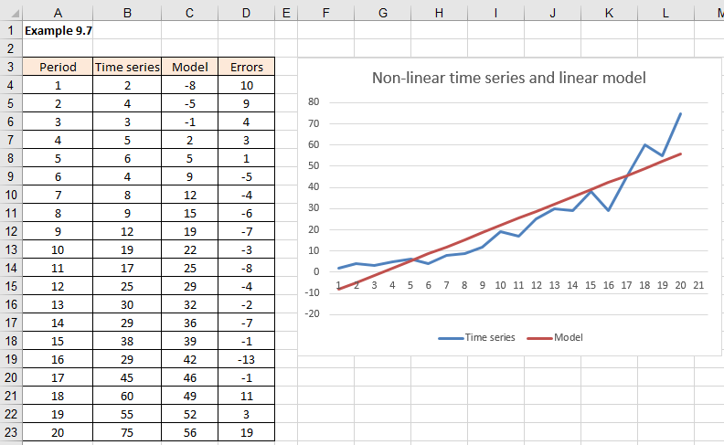
Error measurements (3/7)
Example 10.7
Let’s take a hypothetical and non-linear time series and fit a linear model to it. Figure 10.25 shows a time series that is non-linear, and we deliberately fitted the wrong linear model to it (calculations not shown here).

Slide 37
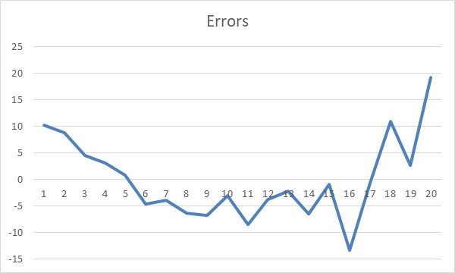
Error measurements (4/7)
If we plot the errors, as in Figure 10.26, they clearly show that they are not random. For the first 6 periods the model data are systematically below the actual data, then they are persistently above and for the last 5 periods, they show a persistent growth. This is an example how errors can help us decide if the model, or the method selected, is the correct one for the data.

Slide 38
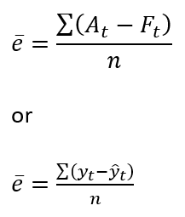
Error measurements (5/7)
As with any other variable, we can sum all the errors and find an average error:
(10.5)
However, as we will see shortly, average error is more often called the Mean Error (ME), and it is just one of many different types of error statistics that we can use to evaluate our model and our forecasts.

Slide 39
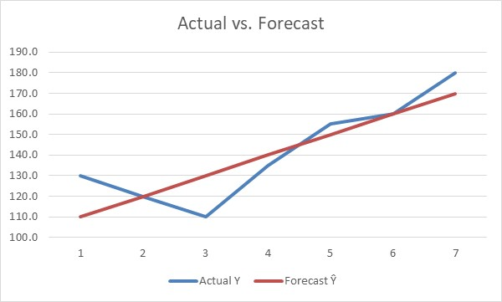
Error measurements (6/7)
Example 10.8
We’ll use the same mini-data sample as in Example 10.3.
Period | Actual Y | Forecast Ŷ
1 | 130.0 | 110
2 | 120.0 | 120
3 | 110.0 | 130
4 | 135.0 | 140
5 | 155.0 | 150
6 | 160.0 | 160
7 | 180.0 | 170
Figure 10.27 shows the results in a graphical way.

Slide 40
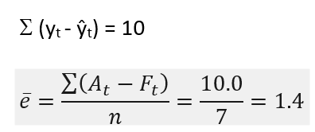
Error measurements (7/7)
Period | Actual Y | Forecast Ŷ | Error
1 | 130.0 | 110 | 20.0
2 | 120.0 | 120 | 0.0
3 | 110.0 | 130 | -20.0
4 | 135.0 | 140 | -5.0
5 | 155.0 | 150 | 5.0
6 | 160.0 | 160 | 0.0
7 | 180.0 | 170 | 10.0
Sum | 990.0 | 980.0 | 10.0
Average | 141.4 | 140.0 | 1.4
The simple calculations of error values are:
From table 10.6:

Slide 41
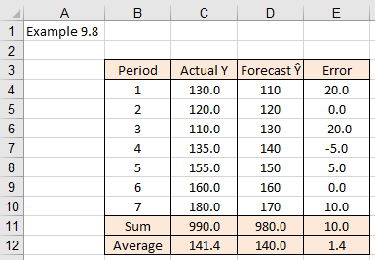
Error measurements - Excel
Figure 10.28 shows an example of how to calculate forecasting errors in Excel.

Slide 42
Error measurements - SPSS
SPSS does not provide errors without the context of the method for which the errors are used. We will, therefore, show how the errors and error statistics are executed in SPSS as we cover different methods.

Slide 43
Types of error statistics (1/2)
A variety of error measurements, or error statistics, can be used to assess how good the forecasts are.
The six most commonly used error statistics are:
Mean error (ME)
Mean absolute error (sometimes called the mean absolute deviation and abbreviated as MAD)
Means square error (MSE)
Root mean square error (RMS)
Mean percentage error (MPE)
Mean absolute percentage error (MAPE).

Slide 44
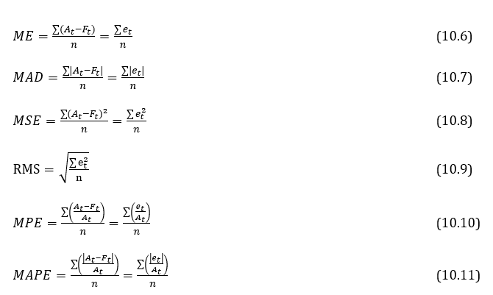
Types of error statistics (2/2)
Where, A_{t} represents the actual values in the time series y_{t}, F_{t} represents the forecasts, or ŷ_{t}, and e_{t} are the errors.
For the number of errors taken into account, we used a symbol of n.

Slide 45
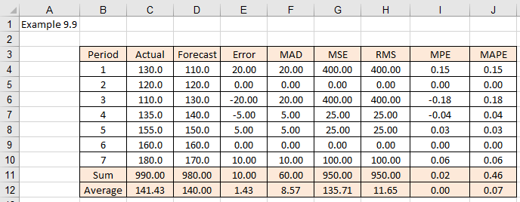
Types of error statistics – Excel (1/4)
Example 10.9
Using the same example as in 10.3 and 10.8, we’ll skip the manual calculations and show how to do these calculations in Excel. Figure 10.29 shows the calculations.

Slide 46
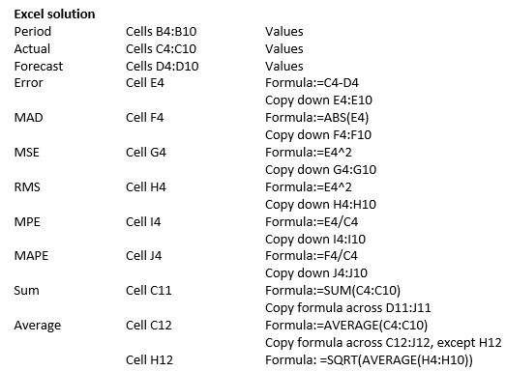
Types of error statistics – Excel (2/4)

Slide 47
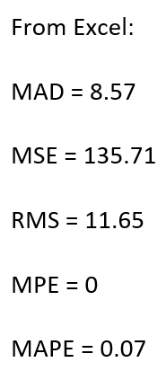
Types of error statistics – Excel (3/4)
There is another, faster method. Rather than calculating individual errors (as in columns E to J) and adding all the individual error values (as in row 9) or calculating the average (as in row 10), we could have calculated all these errors with a single formula line for each type of error.

Slide 48
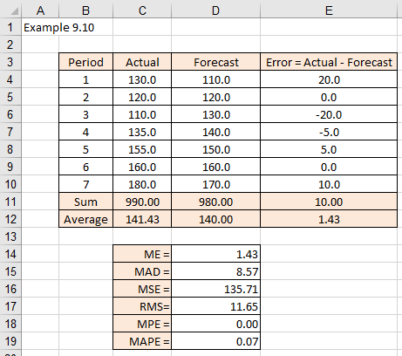
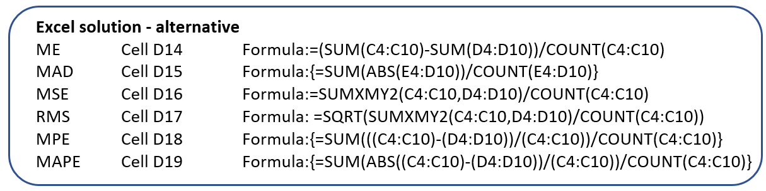
Types of error statistics – Excel (4/4)
Example 10.10
Using some of the built-in Excel functions, these errors can be calculated as illustrated in Figures 10.30.

Slide 49
Types of error statistics – SPSS
SPSS will provide fit measures such as RMSE, MAPE etc when fitting a time series model to the data set using Analyze > Forecasting > Create Traditional Models > Statistics and choosing your model fit statistics.
Unfortunately, you cannot enter actual and forecast data values into SPSS and run the SPSS Forecast command to reproduce these results.

Slide 50
Prediction interval
We need to remind ourselves from the sampling chapter that using the standard error (SE) of the mean, the z-value and the estimated mean value , we are able to make an estimate that the true mean value is somewhere in the interval, defined as the confidence interval CI:
Depending on the value of z, we get different confidence intervals (CI). For example: (a) z = 1.64 for 90% CI, (b) z = 1.96 for 95% CI, and (c) z = 2.58 for 99% CI.
If the sample, or the data set, is relatively short and represents just a small sample of the true population data values, then the t distribution is used for the computation of the confidence interval, rather than the z-value.

Slide 51


Standard errors in time series (1/10)
The standard error of the estimate (SE) measures the differences between every observation and the mean. When dealing with time series, it would seem logical to use the same principle, but rather than calculating deviations from the mean, we calculate deviations between the actual and predicted values.
We can modify equation (5.7) and instead of the mean value use the predicted values as defined by equation (10.14).
10.14
Here are the actual observations and are the predicted values
As we will see shortly, the Excel version of this formula is =SQRT (SUMXMY2 (array_x, array_y)/n-2). Actually, Excel offers an even more elegant function as a substitute for this formula. The function is called: =STEYX (known_y’s, known_x’s). This function returns the standard error of the predicted y-value for each x in the regression.

Slide 52
Standard errors in time series (2/10)
If you investigate Excel’s Help file, you will see that this function is a very elegant representation of a monstrous looking equation given by (10.15).
Either way, remember that Excel formulae =SQRT(SUMXMY2(array_x, array_y)/n-2) and =STEYX(known_y’s, known_x’s) are identical. They both return the standard error for the predicted values. If the standard error SE_{y,x} is a measure of the amount of error in the prediction of y for an individual x. This means we can modify equation (10.13) into equation (10.16).
Where, ŷ are the predicted values, SE_{y,ŷ} is the standard error of prediction and the t_{value} is the t-value from the Student’s t critical table (z-value used for longer time series).

Slide 53
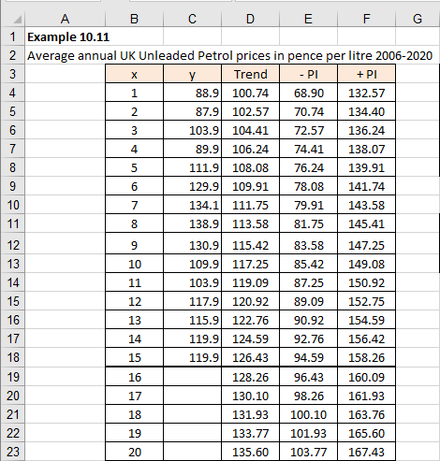
Standard errors in time series (3/10)
Example 10.11
Consider fitting a confidence interval to the Example 10.4 data and provide forecasts for the next ten-time periods. As most of the calculations have already been demonstrated, we’ll use only Excel and SPSS to demonstrate how to do it.
We will use Excel =TREND() function to produce forecasts and calculate the prediction interval for the trend forecasts. Figures 10.31 and 10.32 illustrates the technique.

Slide 54
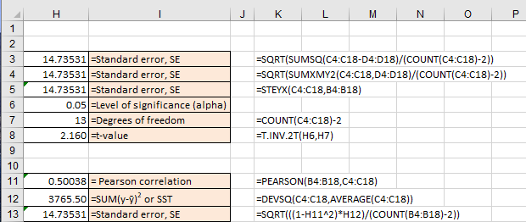
Standard errors in time series (4/10)

Slide 55

Standard errors in time series (5/10)
Note the cell H13, where we provided yet another alternative to calculate the standard error (this gives us H3, H4, H5 and H13 as four alternatives to calculate the same value, using different equations or functions).
The fourth approach in cell H13 is based on the Pearson correlation coefficient and the Total Sum of Squares (SST) to calculate the standard error:
SST is defined by equation (9.13) in the previous chapter.
10.17

Slide 56
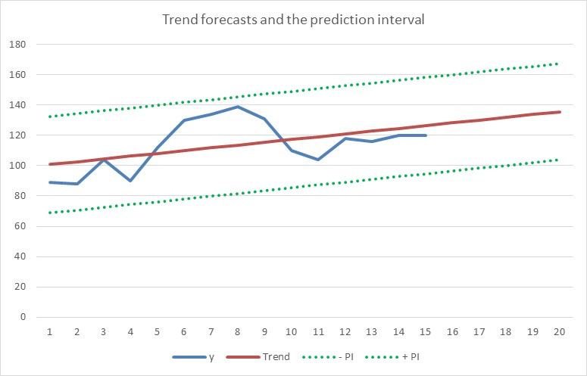
Standard errors in time series (6/10)
Equations (10.14) and (10.17) produce the same value, as we can see from the cells H3 and H4.
Trend function was extrapolated 10 periods in the future.
Figure 10.33 illustrates the graph for the prediction and the corresponding prediction interval.

Slide 57
Standard errors in time series (7/10)
How do we calculate the confidence interval if it changes with time?
As we can see from the above example, the level of confidence here is a constant value. In order to make the confidence level change with time, we will need to replace equation (10.14) with equation (10.18).
Equation (10.18) is very similar to equation (9.22).
THIS IS THE METHOD THAT SPSS WILL USE

Slide 58
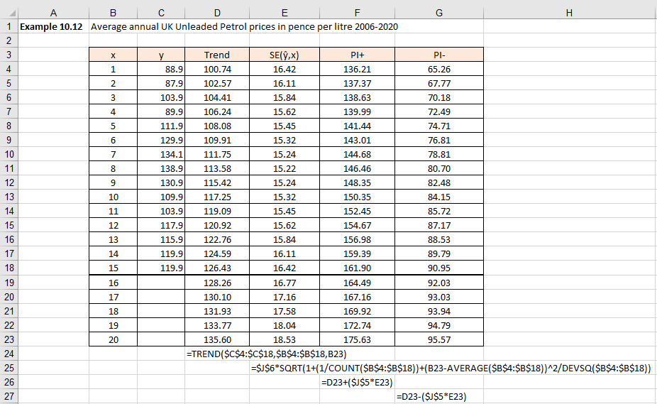
Standard errors in time series (8/10)
Example 10.12
Figures 10.34 and 10.35 illustrates the Excel solution to calculate interval estimate.
The only difference between Figure 10.31 and Figure 10.34 is that we had to introduce one additional columns for the SE_{y,x} (column E in Figure 10.34).

Slide 59
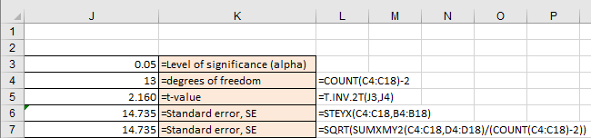
Standard errors in time series (9/10)

Slide 60
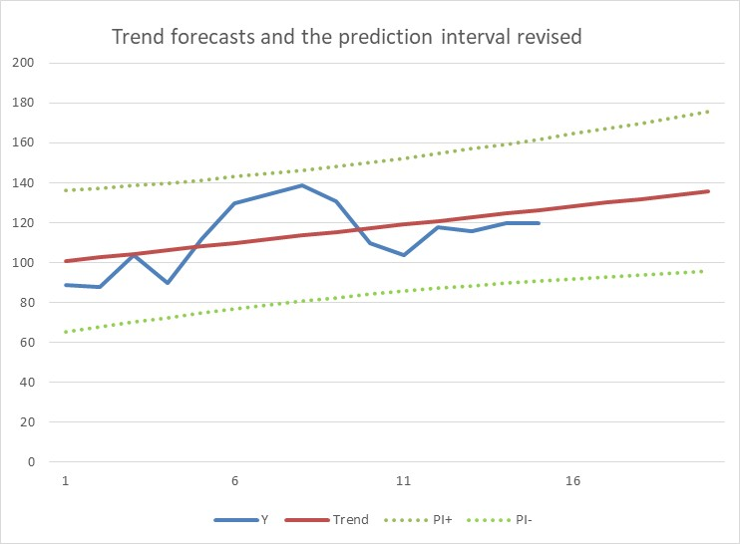
Standard errors in time series (10/10)
Figure 10.36 illustrates the Excel graphical solution.

Slide 61
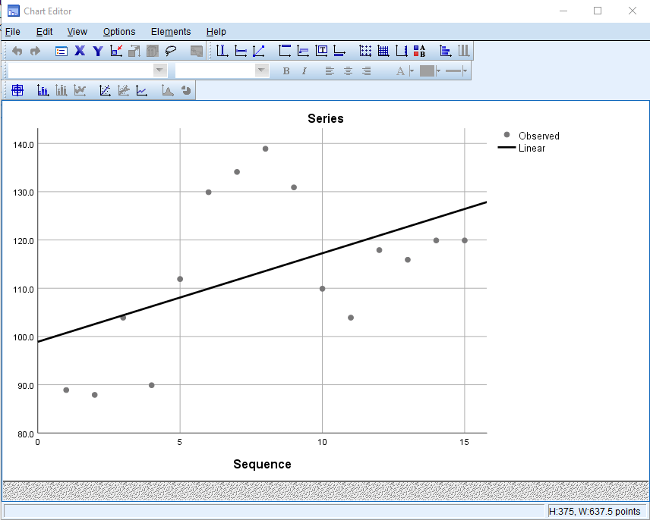
Standard errors in time series - SPSS(1/5)
In order to understand how to implement these calculations in SPSS, you first need to go back to Example 10.4 and repeat what has been shown in Figures 10.14 to 10.19. Figures 10.18 and 10.19 contain already the prediction interval and it is marked as LCL (Lower Confidence Level) and UCL (Upper Confidence Level). We will continue with the analysis after you stopped at Figure 10.21 and will add a confidence interval to graph.
Modify graph to include the confidence interval
Copy graph and then double click on the trendline – this will open the Chart Editor

Slide 62
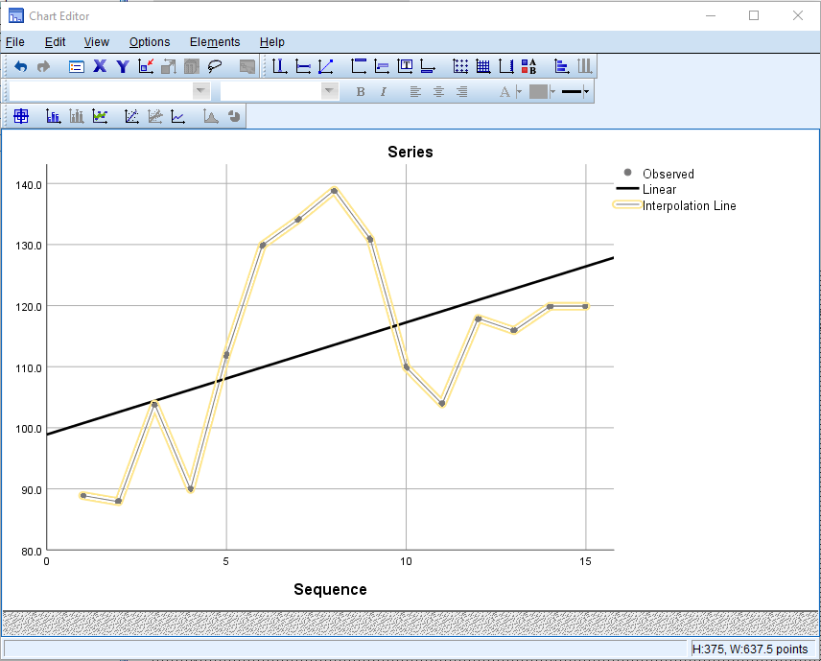
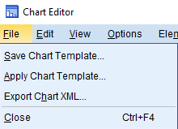
Standard errors in time series (2/5)
Click onto add an interpolation line – this joins the data points together with a straight line.
Click on File > Close as illustrated in Figure 10.40

Slide 63
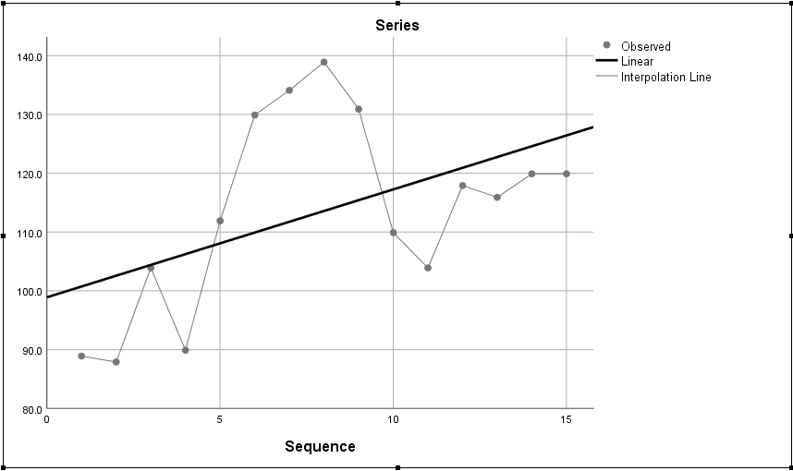
Standard errors in time series (3/5)

Slide 64
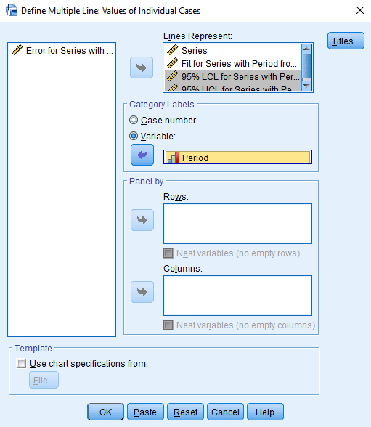
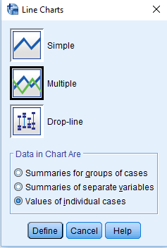
Standard errors in time series (4/5)
Now fit the confidence interval using LCL_1 and UCL_1 calculated values
Select Graphs > Legacy Dialogs > Line
Choose Multiple
Choose Data in Chart Are: Values of individual cases
Select Define
Transfer into Lines Represent box: Series, Fit for Series …., 95% LCL…, and 95% UCL ….
In Category Labels, choose Variable and transfer Period into box
Select OK

Slide 65

Standard errors in time series (5/5)
This agrees with the Excel solution illustrated in Example 10.12

Slide 66
Conclusion
Part 1 and 2 presentations provide a set of tools which can be used to analyse time series data:
Fitting a Trend
Forecasting errors
Prediction intervals

